Slide 1

EYESFIRST GAMES
Eye Tracking API .
Pradeep Kumar

Slide 2

GAMES :
Tile Slide
Match Two
Double Up and
Maze

Slide 3
What is Eyes First Games ?
Eyes first games are popular games reinvented for an “Eyes First” experience.
They are powered by Windows 10 eye tracking APIs and can be used with or without Windows 10 Eye Control , a key accessibility feature for people with speech and mobility disabilities.
Microsoft Research has published four “Eyes First” games, designed to help make eye tracking more of a mainstream technology for Windows 10 users.

Slide 4
Tools :
Eye-tracking hardware from Tobii-Tobii Eye Control 4C.
PC with windows 10 2018 Update or newer.

Slide 5

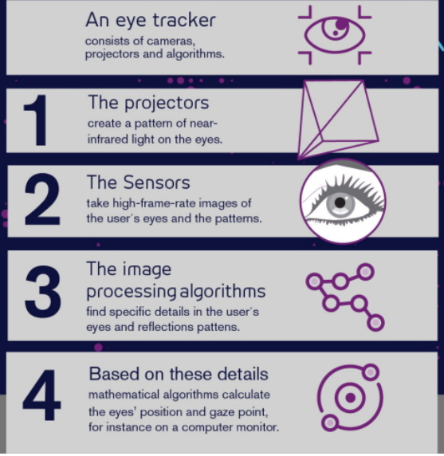
What is Eye tracking ?
Eye tracking is a technology that is used to control devices with just eyes.
Components of Eye tracker :
Advanced micro projectors –creates a pattern of near-infrared light on the eye.
The sensors – takes high-frame-rate images of the user’s eyes and the patterns
The image-processing algorithms – find specific details in the user’s eyes and reflections patterns.
User-oriented applications – intelligent application layer added to enable the various ways technology can be used .

Slide 6
What is Digital image Processing ?
Processing digital image by means of digital Computer.
In other words ,it uses computer Algorithms to get enhanced image to extract some useful information.

Slide 7
Digital image processing
Digital image processing allows the use of much more complex algorithms, and hence, can offer both more sophisticated performance at simple tasks, and the implementation of methods which would be impossible by analog means.
In particular, digital image processing is the only practical technology for
Classification
Feature extraction
Multi-scale signal analysis
Pattern recognition
Projection

Slide 8

Main Steps in Image Processing :
Importing the image via image acquisition tools
Analyzing and manipulating the image
Output in which result can be altered image or a report which is based on analyzing that image

Slide 9

Image and types of image :
It is defined as two-dimensional function, F(x, y) where x and y are spatial coordinates, and amplitude of F at any (x, y) is called the “Intensity” of that image at that point.
When x,y, and amplitude of F are finite, we call it a “Digital image”.
Types of images :
Binary Image – 0 or 1 (Monochrome)
Black and White Image
8-bit Color Format (Grayscale Image)- 256 shades, 0- Black ,255- White and 127-gray
16-bit Color Format (High Color Format)– 65,536 colors , RGB( Red, Green, Blue)

Slide 10
Phases of Image Processing :
Acquisition - image which is in digital form(Scaling , Conversion)
Image Enhancement – extracting hidden details
Image Restoration - Appealing of an image but it is objective
Color Image Processing - Pseudo color and full color Image processing color models.
Wavelets and Multi-Resolution Processing – representing images in various degrees
Image Compression - image size or resolution
Morphological Processing - extracting image components for representation and shape .
Segmentation Procedure - Partitioning an image into its constituent parts or objects
Representation and Description - transforming raw data into processed data.
Object Detection and Recognition - Assigns a label to an object based on its descriptor.

Slide 11
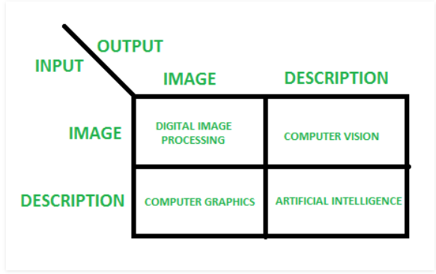
Overlapping fields with Image Processing

Slide 12

References :
https://www.microsoft.com/en-us/research/product/eyes-first/
https://www.tobii.com/tech/technology/what-is-eye-tracking/
https://en.wikipedia.org/wiki/Digital_image_processing
https://en.wikipedia.org/wiki/Pattern_recognition
https://www.geeksforgeeks.org/digital-image-processing-basics/

Slide 13
End

